Slide 1
Hospital Data Entry

Slide 2
Team Members
2010030552 – Perla Nada Asish
2010030553 – Gopu Akshaya
2010030556 – Marri Sahasra Reddy

Slide 3
Table Content
Problem Statement
Abstract
Proposed System
Requirement Analysis
Scope of the system
Class Diagram
Sample I/O
Conclusion
Future Enhancement

Slide 4
Problem Statement
• The problem with the convention system is the information was very difficult to retrieve and to find a particular information like to find about the patient’s history the user has to go through various registers.
• As Hospital consists of numbers of patient n staff, number of patient comes to hospital for their treatment so every time there is a need to update the patient details or insert the details of the patient like from which diseases they are suffering from which doctor they are consulting to maintain all this record it’s not possible to search every time for the patient and specially when all records are kept manually.
• So to manage this huge system there is a requirement of such software in which all data can be keep safe and upgrade to update the data delete or insert the records of any of the staff, doctor, patient this system is easy to use and access the records of all staff and patients of the hospital by using this system it become more easy to fetch information and it provides data security too.

Slide 5
Abstract
• Hospitals are currently using a manual system for the management and maintenance of critical information.
• The current system requires numerous paper forms, with data stores spread throughout the hospital management infrastructure.
• The information on the forms is incomplete, or does not follow management standards.
• Multiple copies of the same information exist in the hospital and may lead to inconsistencies in data in various data stores.

Slide 6
Proposed System
The Hospital Management System is designed for any Hospital to replace their existing manual, paper based system.
The new system is to control the following information they are as follows as: patient information, room availability, doctor’s information, and bills information and so on this services are to be provided in an efficient, cost effective manner, with the goal of reducing the time and resources currently required for such task.
Advantages :
Easy to Use • Patients details can be updated easily
Patients Documents can be stored. • User can fetch the details of patient in one click
Patients detail can be stored easily
Bills receipt in one click

Slide 7
REQUIREMENT ANALYSIS
Software Environment:
Software Environment is a technical specification of requirement of software product. This specifies the environment for development, operation and maintenance of the product.
Technology Used :
->JAVA
->SQL

Slide 8
Working Environment
Hardware
Processor:
RAM:
Hard Disk Drive:
Keyboard:
Monitor:
Configuration:
Intel Core
512 MB RAM
40 GB HDD
104 keys
15” digital colour monitor

Slide 9
Scope of the system
The proposed software product is the Hospital Management System. The system will be used in any Hospital, Clinic, Dispensary or Pathology labs in any Hospital, Clinics, Dispensary or Pathology labs to get the information from the patient and storing the data for future usage. The current system in use is a paper based system. It is too slow and cannot provide updated lists of patients within the reasonable timeframe. The intentions of the system are to reduce over – time pay and increase the number of patients that can be treated accurately. Requirements statements in these documents are both functional and non – functional.

Slide 10
The current project elucidates the following features are as follows a
Registering the Patients
Updating the Patients Information
Searching details of Patients
searching of availability of wards
Bills of the patients and ward charges

Slide 11
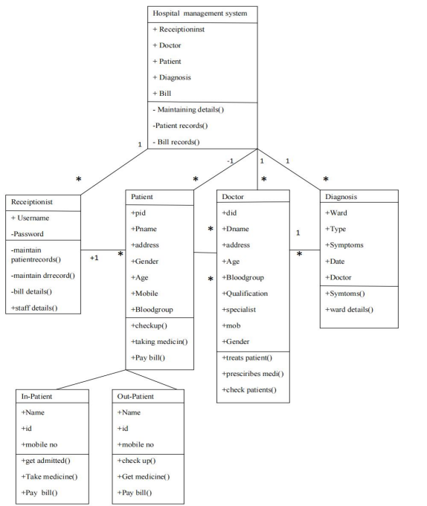
Class Diagram

Slide 12
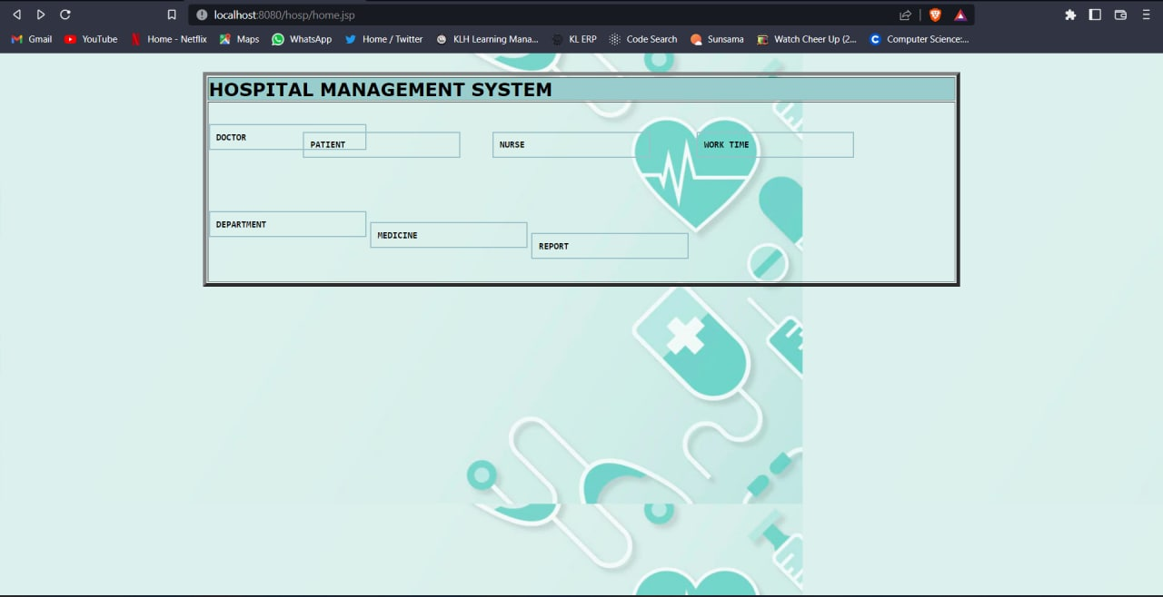
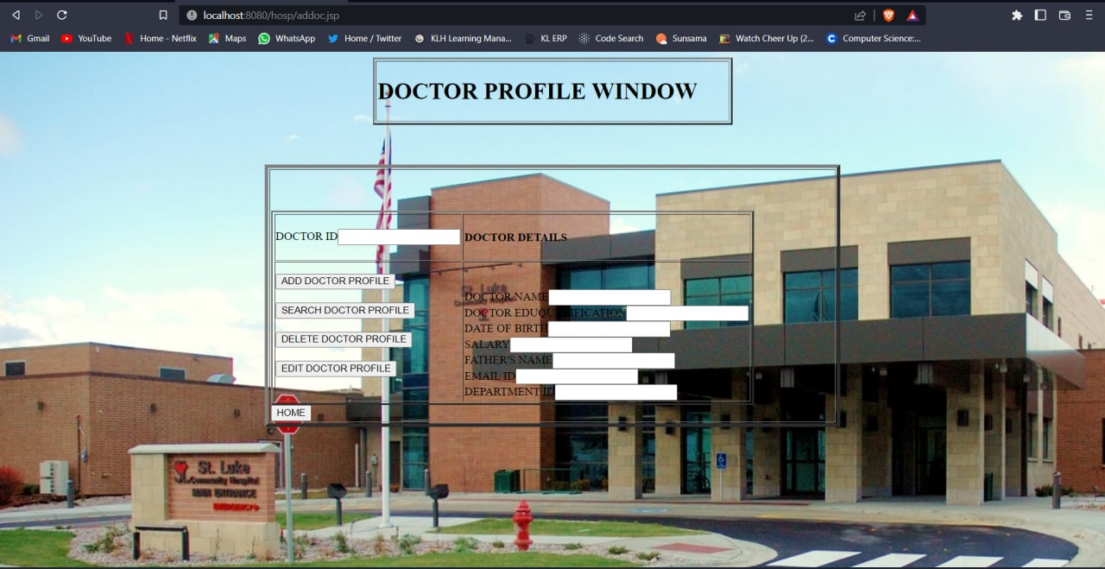
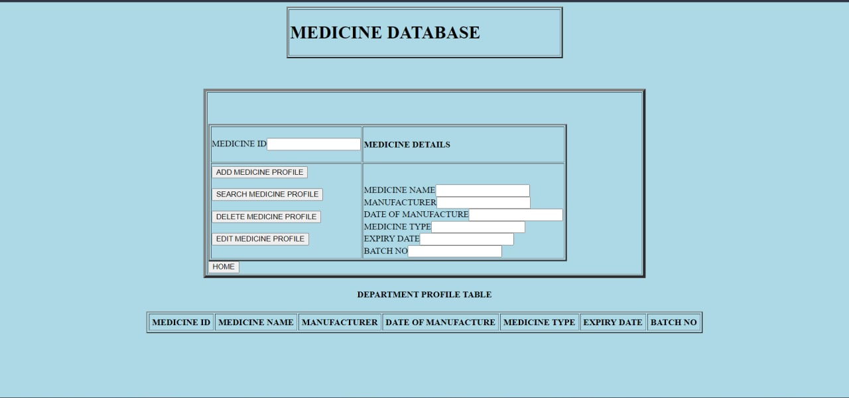
SAMPLE I/O

Slide 13
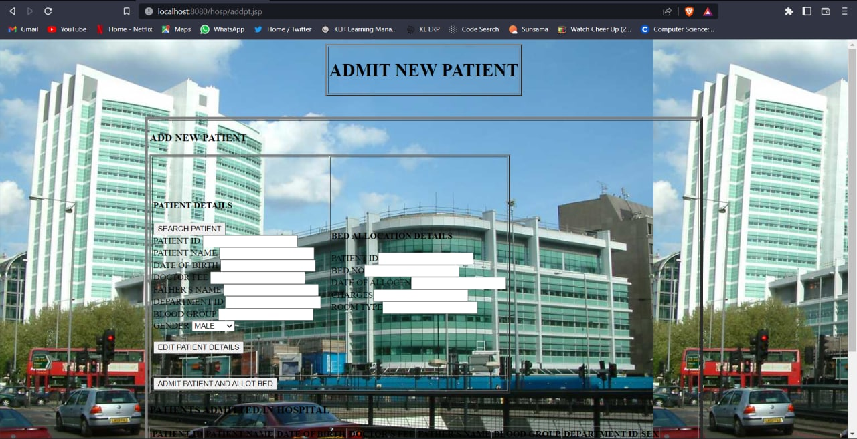
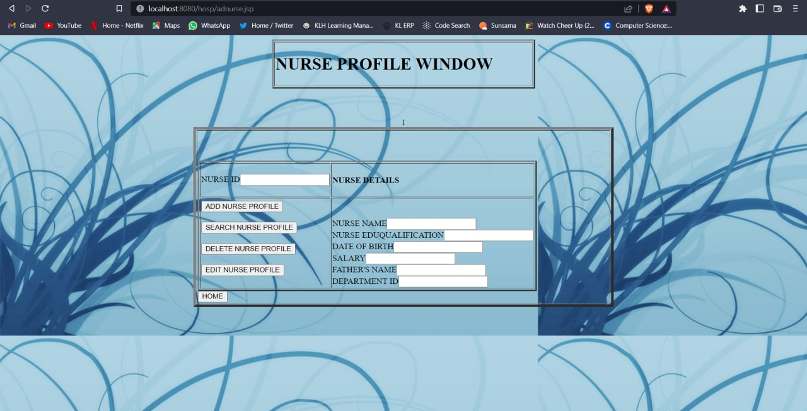
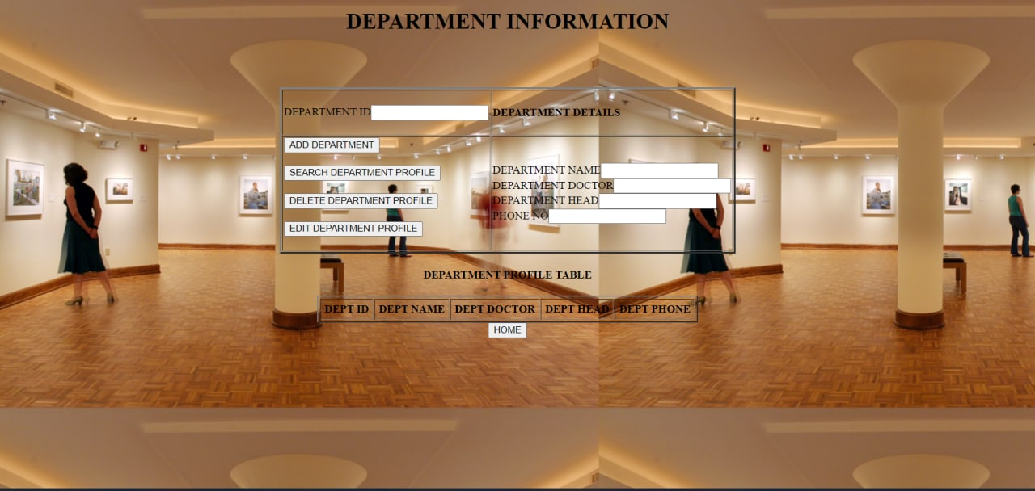

Slide 14
CONCLUSION
This project has given me an ample opportunity to design, code, test and implements an application. This has helped in putting into practice of various Software Engineering principles and Database Management concepts like maintaining integrity and consistency of data. Further, this has helped me to learn more about POSTGRESQL, JAVA, Adobe Photoshop 7.0.

Slide 15
Future Enhancement
The proposed system is Hospital Management System
We can enhance this system by including more facilities like pharmacy system for the stock details of medicines in the pharmacy.
Providing such features enable the users to include more comments into the system.50

Slide 16
THANK YOU!!

